Slide 1
Variations of FFT and its Applications
Asis Kumar Rout(181IT108) Ph : 8249247838
Ashok Bhobhiya(181IT154) Ph : 7426949077
Jeeukrishnan Kayshyap(181IT220) Ph : 9101265983
Mukesh Siyak (181IT228) Ph : 9610034481

Slide 2
Number Theoretic Transform

Slide 3
What is it?
NTT = specialized version of the discrete Fourier transform
To multiply 2 polynomials such that the coefficient of the resultant polynomials are calculated under a particular modulo.
Naive algorithm for NTT has complexity O(N^2 ). (Complexity = number of ring operations in Fp.)
How to improve ?

Slide 4
Runtime Improve?
We can do better with the help of FFT.
FFT runs with N*log(N) so, it could be run with same.

Slide 5
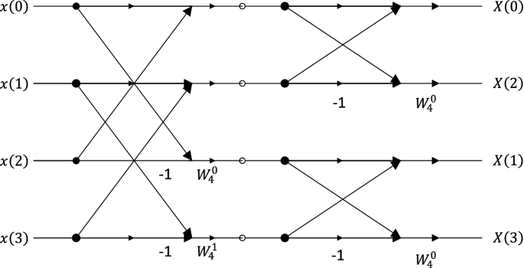
FFT

Slide 6
NTT Vs FFT
The main (or the only) difference between FFT and NTT is that the first operates over reals, while the second operates over a finite field. This way, FFT uses wN = exp(2j*pi/N) as a primitive root, while NTT is able to use a generator of the finite field.
The benefit of NTT is that there are no precision errors as all the calculations are done in integers.

Slide 7
Uses
The Number Theoretic Transform (NTT) provides efficient algorithms for cyclic and negacyclic convolutions, which have many applications in computer arithmetic, e.g., for multiplying large integers and large degree polynomials.

Slide 8
Drawback
A major drawback of NTT is that generally we are only able to do NTT with a prime modulo of the form 2k·c + 1 otherwise it increases time complexity.
To do it for a random mod we need to use CRT (Chinese Remainder Theorem).
Other drawback for ntt is that it can only work with integers we can’t use floating point polynomials here.

Slide 9
Fast Walsh-Hadamard

Slide 10
MOTIVATION(APPLICATION OF FWHT)
Given an array of N numbers,we can choose any subset of numbers and compute their binary and( & operator).We need to find the number of distinct results we can get.
Brute-force Approach.
Can we do anything better?
XOR Convolution

Slide 11
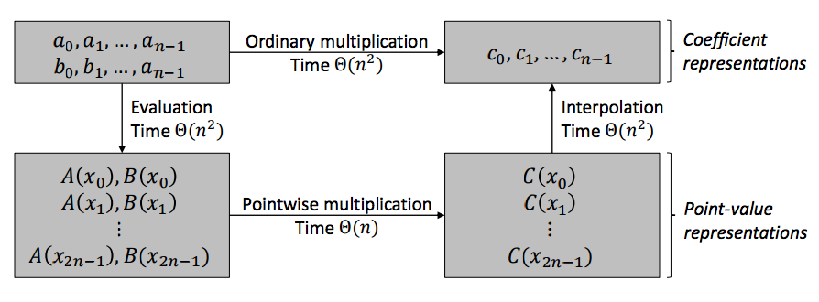
MULTIPLICATION ANALOGY WITH FFT

Slide 12
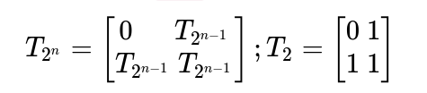
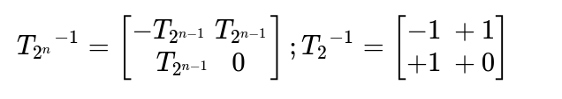
Fast Walsh-Hadamard Transform
Divide Conquer Algorithm

Slide 13
SOLVING USING FAST WALSH-HADAMARD
Let P be a polynomial with its coefficient presentation C
{ C[i]=1 if i belongs to input else C[i]=0}
Apply transformation to this polynomial (P' = T. P )
Raise P' to the Power N (P' ^ N = P' * P' * P' ....)
Apply the inverse transformation(P' = T^-1 * P)

